Slide 1
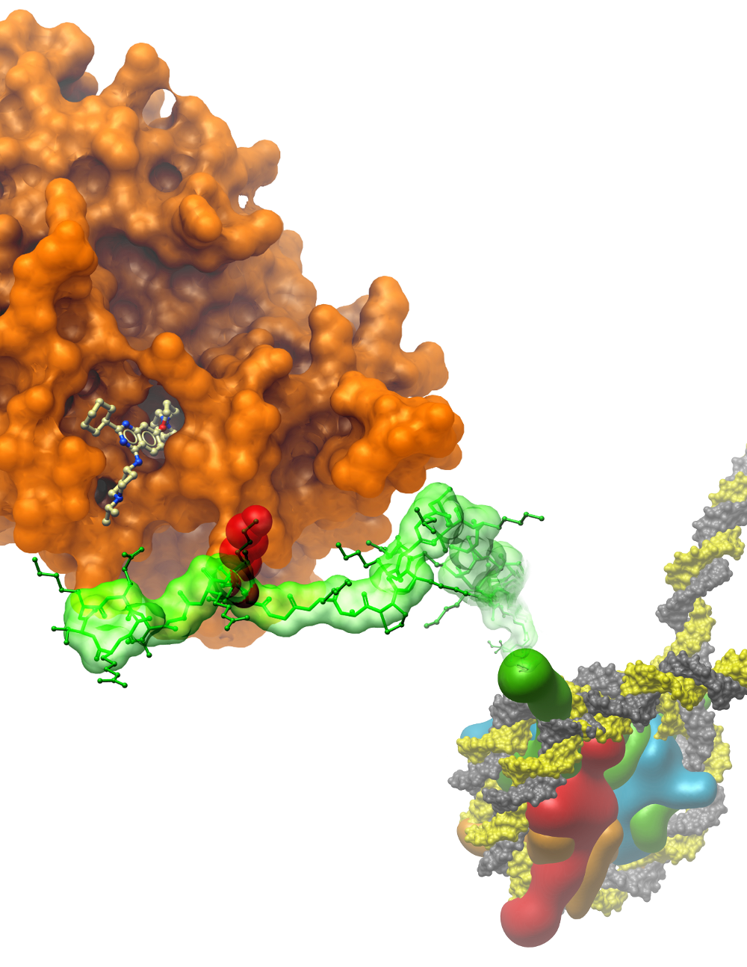









Relative Binding Energy Prediction for WDR91 DEL-ML compounds
Conrad Simoben
SGC Toronto
29 October 2023

Slide 2
INTRODUCTION
Free-energy perturbation (FEP) is the state-of-the-art cheminformatic approach being used to estimate the free-energy difference between two systems within a congeneric series.
The methods have been reported to be more successful in reproducing experimental activities as compared to other traditional methods like MM-GB/PB(SA), docking.
In this study, we aim to predict and suggest the activities of molecules that can target the WD-repeat domain of human WDR91.

Slide 3
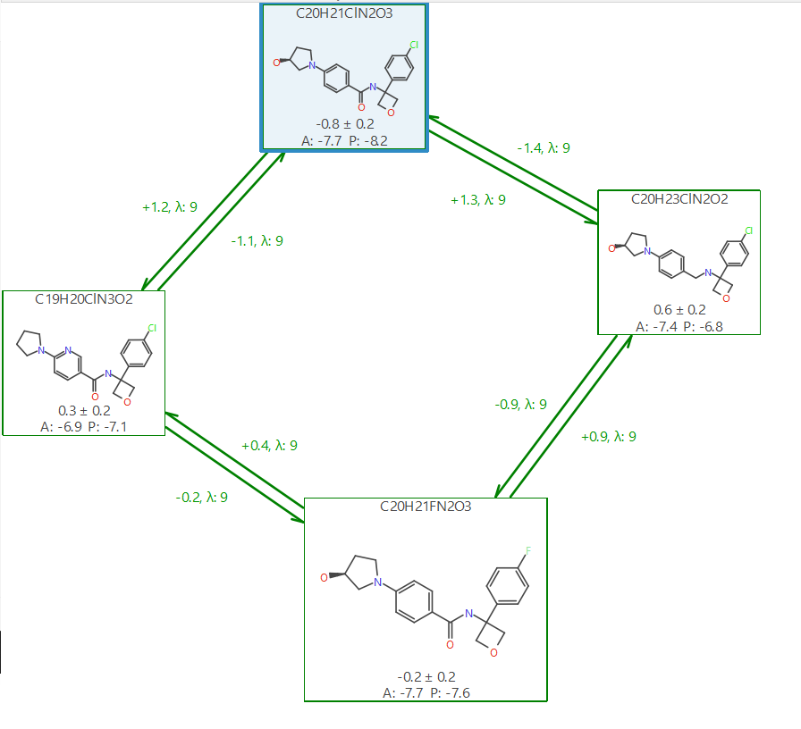
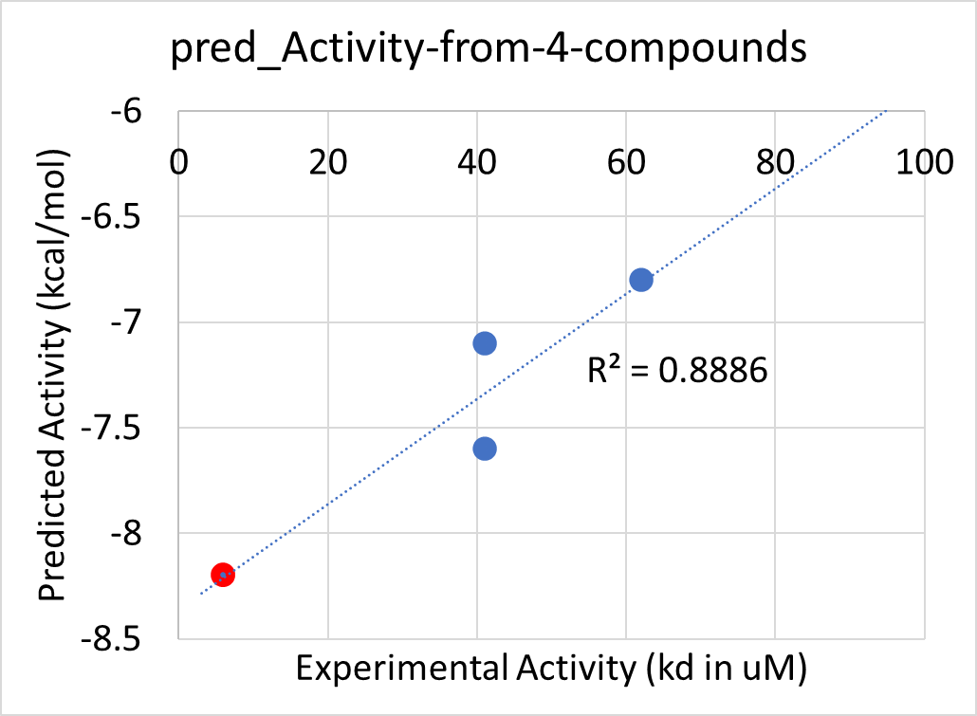
Predictions From the 4 molecules system
Crystalized Ligand

Slide 4
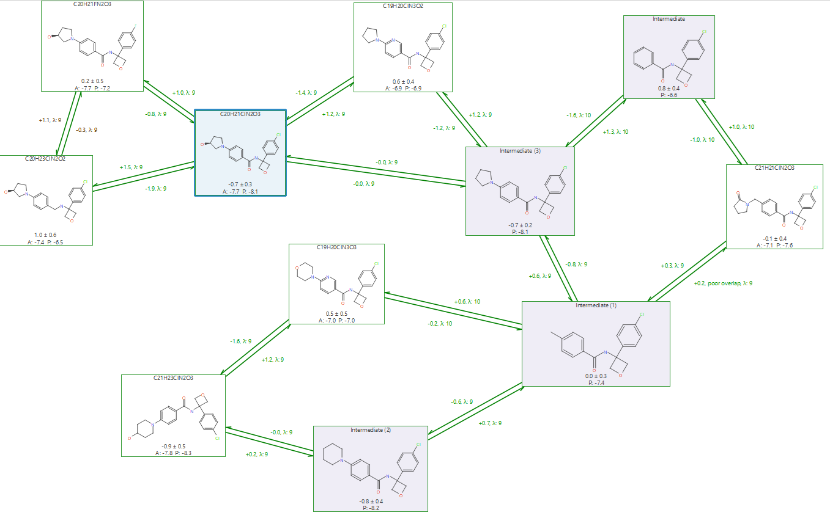
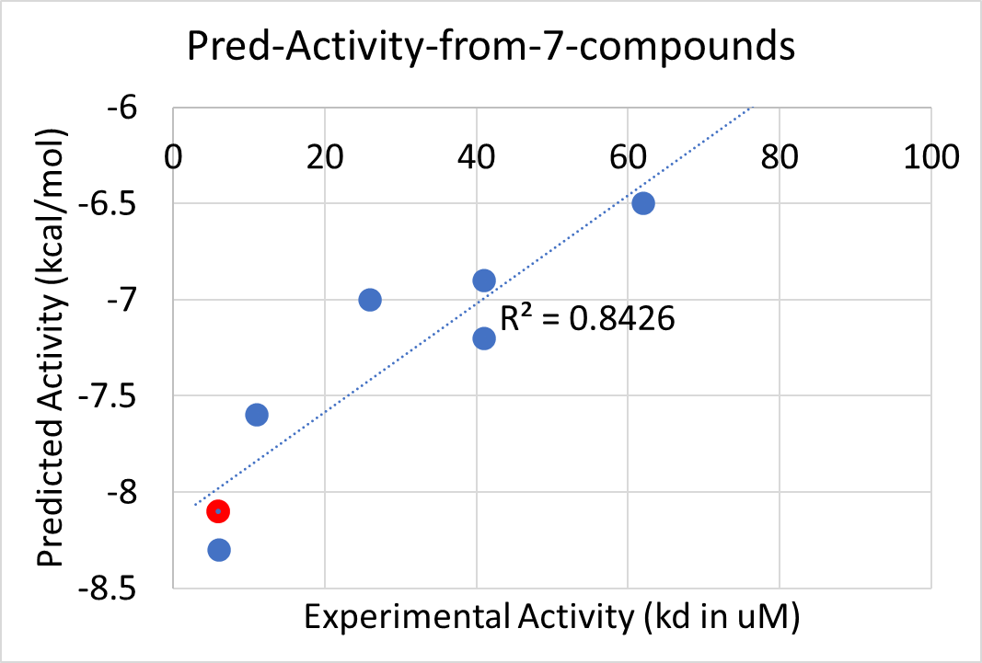
Predictions From the 7 molecules system
Crystalized Ligand
Docking score (kcal/mol)

Slide 5
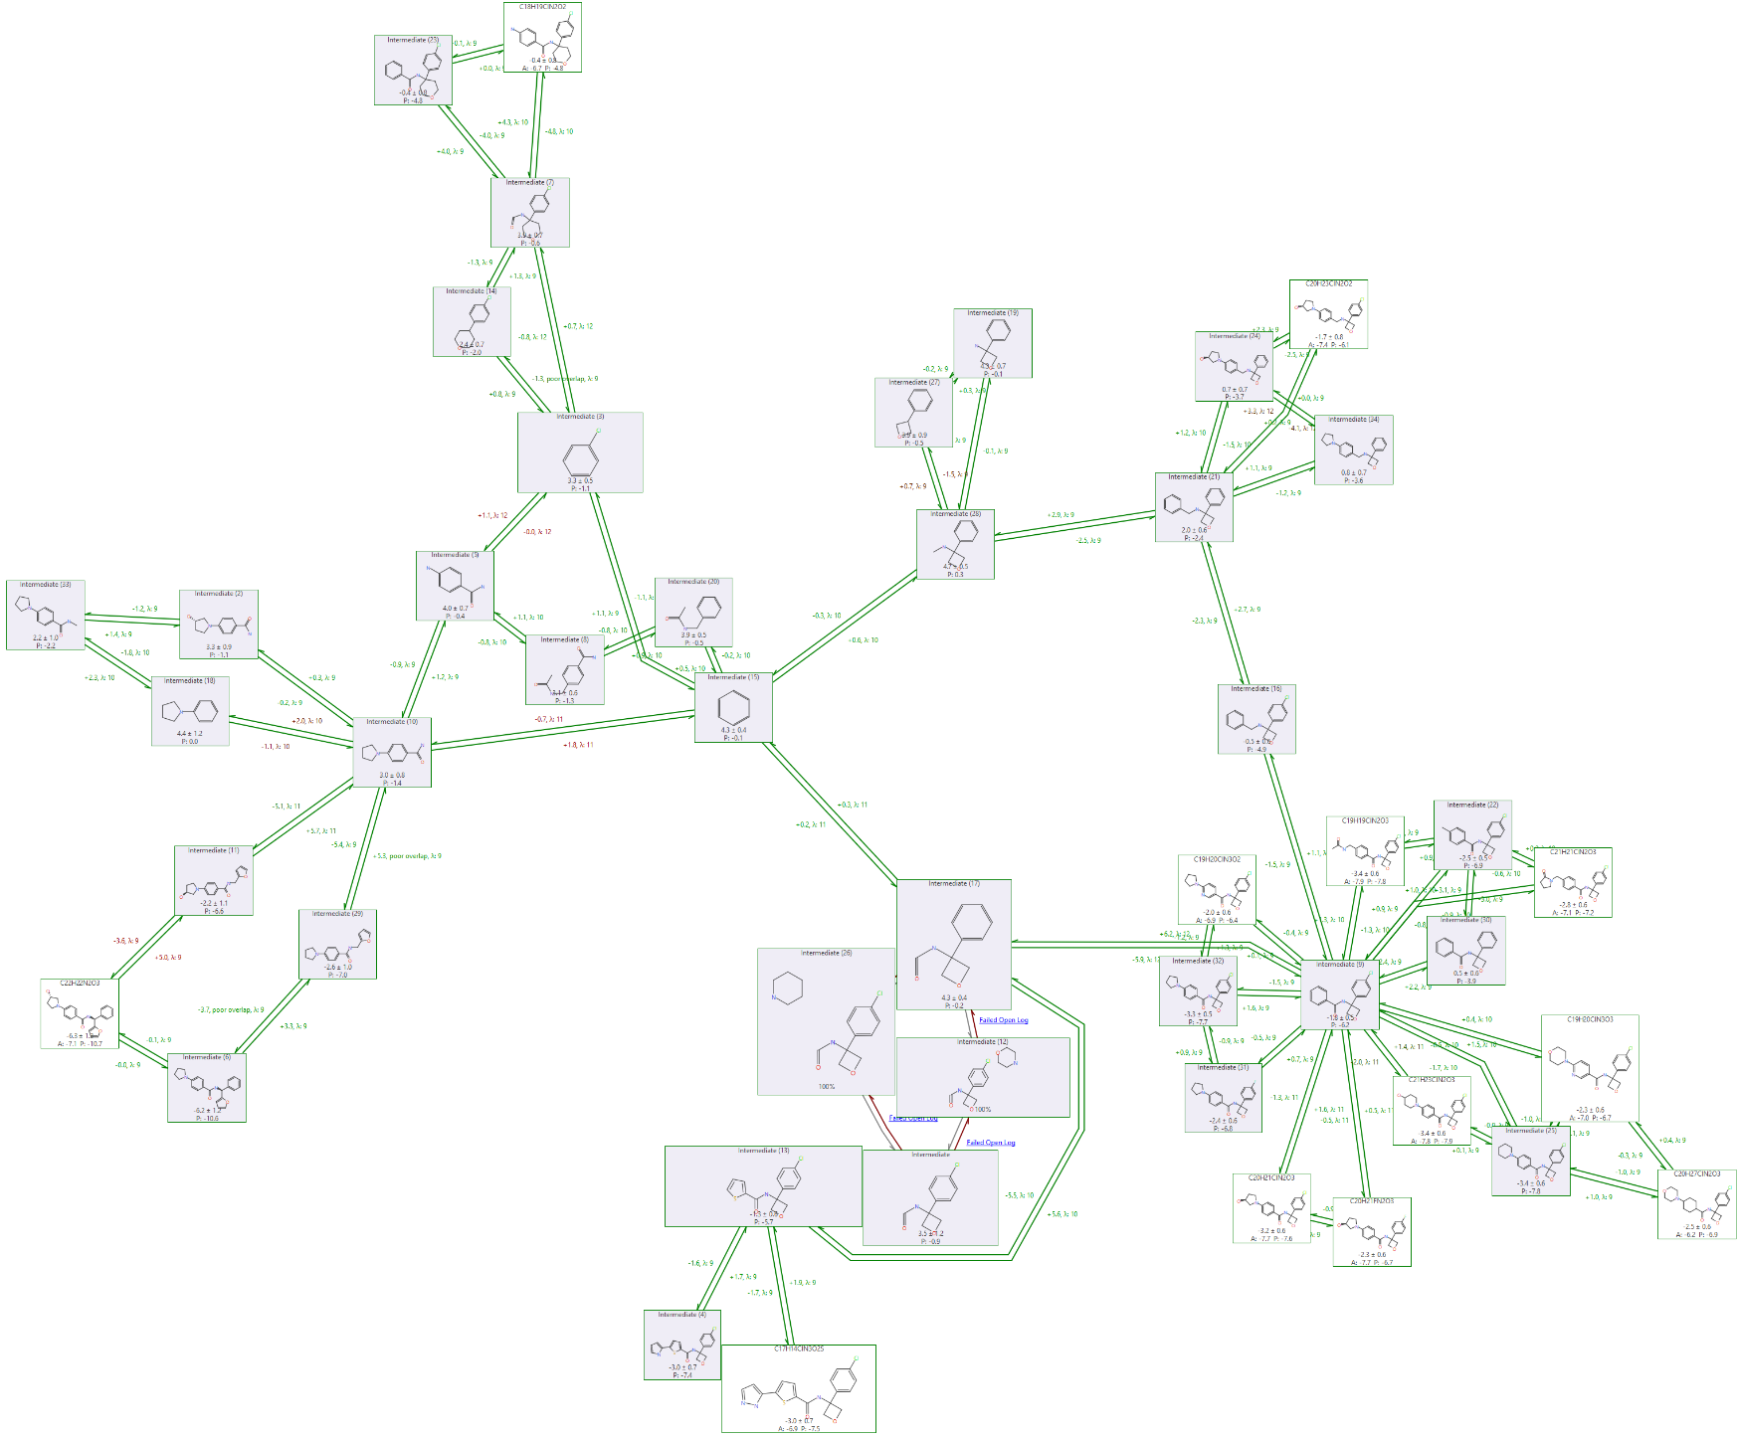
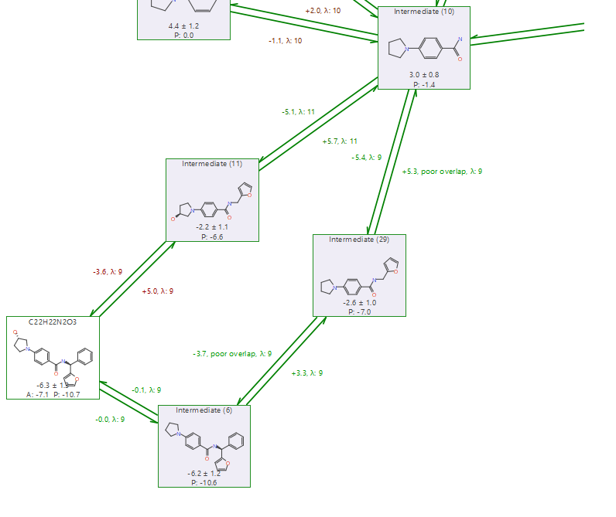
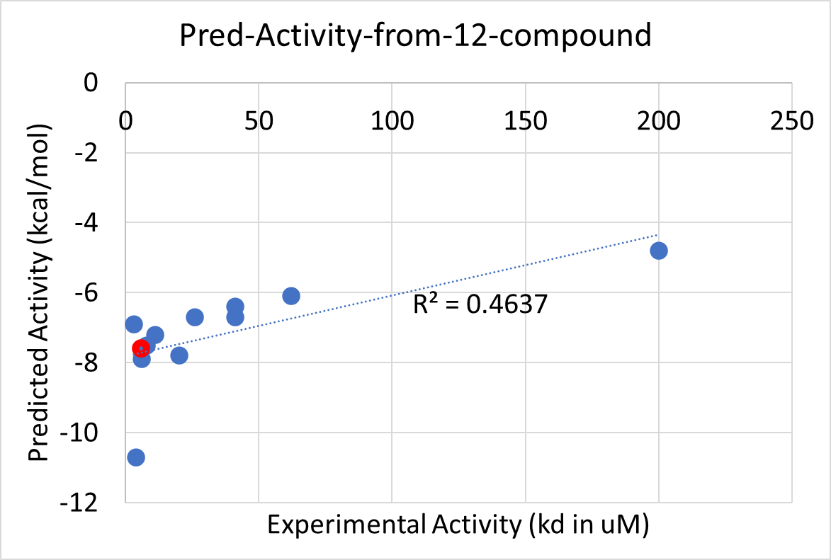
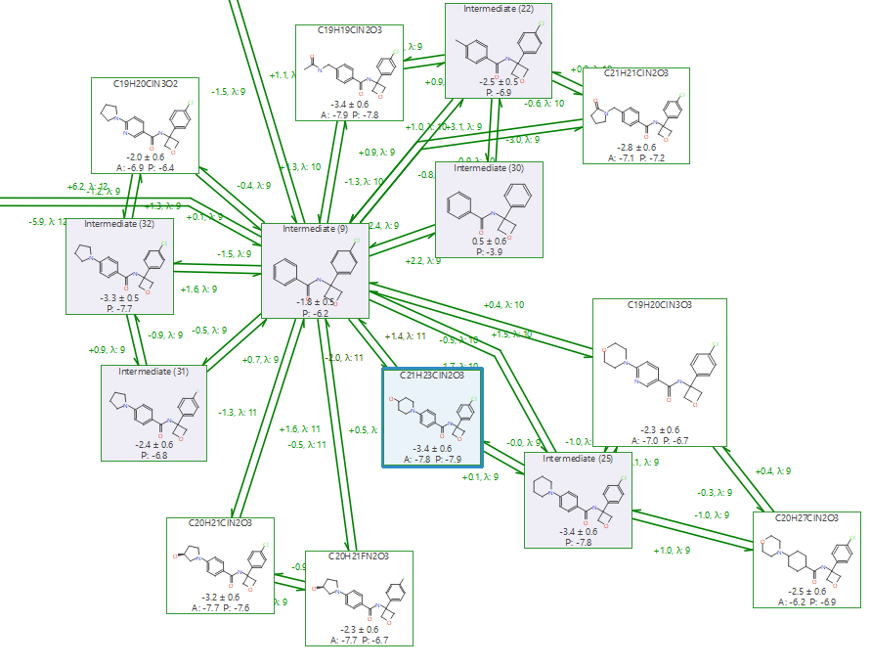
Predictions From the 12 molecules system
The red mark represents the crystalized ligand

Slide 6
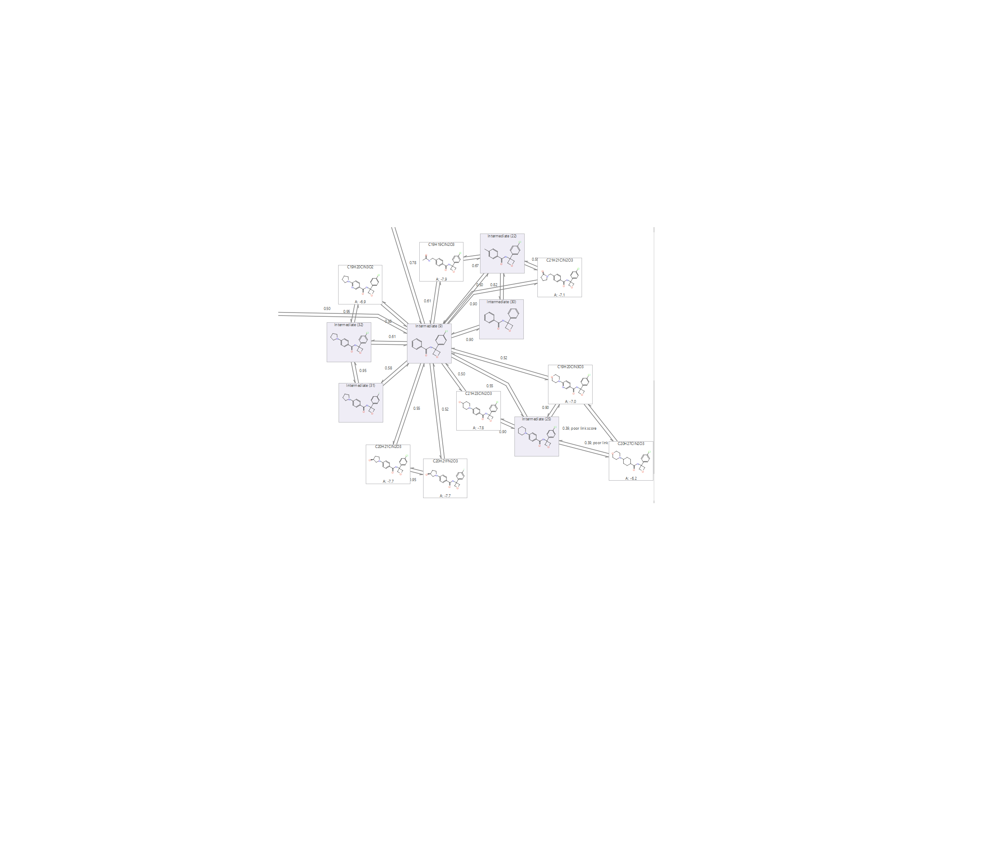
ACKNOWLEDGEMENTS
SGC Toronto Informatics Group
Matthieu Schapira
www.thesgc.org
FUNDING PARTNERS
The Structural Genomics Consortium is a registered charity (no: 1097737) that receives funds from Bayer AG, Boehringer Ingelheim, Bristol Myers Squibb, Genentech, Genome Canada through Ontario Genomics Institute [OGI-196], EU/EFPIA/OICR/McGill/KTH/Diamond Innovative Medicines Initiative 2 Joint Undertaking [EUbOPEN grant 875510], Janssen, Merck KGaA (aka EMD in Canada and US), Pfizer and Takeda.

